Slide 1
Lecture 11 Heaps
Department of Computer Science
Hofstra University
Acknowledgement: Lecture slides based on UofW Course on Data Structures

Slide 2
Priority Queue ADT
Binary Heap
Binary Heap Methods

Slide 3
Priority Queue ADT
Priority Queues are commonly used for sorting
If a Queue is “First-In-First-Out” (FIFO) Priority Queues are “Most-Important-Out-First”
Items in Priority Queue must be comparable – The data structure will maintain some amount of internal sorting, in a sort of similar way to BSTs/AVLs
Min Priority Queue ADT
Max Priority Queue ADT
state
state
Set of comparable values
- Ordered based on “priority”
Set of comparable values
- Ordered based on “priority”
behavior
behavior
removeMin() – returns the element with the smallest priority, removes it from the collection
removeMax() – returns the element with the largest priority, removes it from the collection
peekMin() – find, but do not remove the element with the smallest priority
peekMax() – find, but do not remove the element with the largest priority
add(value) – add a new element to the collection
add(value) – add a new element to the collection

Slide 4
Implementing Priority Queues: Take I
Maybe we already know how to implement a priority queue.
How long would removeMin and peek take with these data structures?
Implementation | add | removeMin | Peek
Unsorted Array | O(1) | O(n) | O(n)
Linked List (sorted) | O(n) | O(1) | O(1)
AVL Tree | O(log n) | O(log n) | O(log n)
For Array implementations, assume you do not need to resize.
Other than this assumption, do worst case analysis.

Slide 5
Implementing Priority Queues: Take I
Maybe we already know how to implement a priority queue.
How long would removeMin and peek take with these data structures?
Implementation | add | removeMin | Peek
Unsorted Array | O(1) | O(n) | O(n) O(1)
Linked List (sorted) | O(n) | O(1) | O(1)
AVL Tree | O(log n) | O(log n) | O(log n) O(1)
AVL Trees are our baseline – let’s look at what computer scientists came up with as an alternative, analyze that, and then come back to AVL Tree as an option later
Add a field to keep track of the min. Update on every insert or remove.

Slide 6
Priority Queue ADT
Binary Heap
Binary Heap Methods

Slide 7
Heaps
In a BST, we organized the data to find anything quickly. (go left or right to find a value deeper in the tree)
Now we just want to find the smallest item fast, so let’s write a different invariant:
Heap invariant Every node is less than or equal to both of its children.
4
In particular, the smallest node is at the root!
Do we need more invariants?
4
5
6
5
6
8
9
7
7

Slide 8
Heaps
We want to avoid degenerate trees (linear linked lists).
The heap invariant is less strict (looser) than the BST invariant, so we can impose stricter invariants on tree structure
A BST is an ordered, or sorted, binary tree, with the following invariants:
For every node with key k:
The left subtree has only keys smaller than k
The right subtree has only keys greater than k
This invariant applies recursively throughout tree
4
5
a degenerate tree
6
7
…
Recall: BST Invariant
Notes:
With the current definition we could still have degenerate trees (linear linked lists).
From our BST / AVL intuition, we know that degenerate trees take a long time to traverse from root to leaf, so

Slide 9
Heaps
Heap structure invariant: A heap is always a complete tree.
helps to avoid degenerate trees
A tree is complete if:
Every row, except potentially the last, is completely full
The last row is filled from left to right (no “gap”)
4
4
2
2
6
5
6
5
8
9
7
8
7
complete
not complete

Slide 10
Complete Binary Tree or Not?
Above: complete binary trees
Below: not complete binary trees
Leaf level is not filled from left to right.
Non-leaf level is not completely filled.

Slide 11
Binary Heap invariants
A binary heap satisfies the following invariants:
Binary Tree: every node has at most 2 children
Heap invariant: every node is smaller than (or equal to) its children
Heap structure invariant: each level is “complete” meaning it has no “gaps”
Heaps are filled up left to right
1
1
2
3
8
2
3
22
4
5
9
10
4
5
6
7
36
47
8
9
10
Valid heap
Valid heap
Invalid heap

Slide 12
Quiz - Are these valid heaps?
Binary Heap Invariants:
Binary Tree
Heap
Complete
4
1
4
2
5
3
7
5
3
7
8
7
9
8
6
9
11
10
6
Invalid
Invalid
Valid

Slide 13
Quiz - Are these valid heaps?
Binary Heap Invariants:
Binary Tree
Heap
Complete
1
2
2
3
8
3
5
22
4
5
9
10
9
11
4
7
36
47
8
9
10
Valid
Invalid
Invalid

Slide 14
Heap heights
A binary heap bounds our height at O(log(n)) because it’s complete. This means the runtime to traverse from root to leaf or leaf to root will be log(n) time.
2
4
7
5
8
10
9
11
13

Slide 15
Priority Queue ADT
Binary Heap
Binary Heap Methods

Slide 16

Implementing peekMin()
2
4
7
5
8
10
9
11
13

Slide 17
Implementing removeMin()
1. Return min
2. Replace with bottom level right-most node
2
13
4
7
4
7
5
8
10
9
5
8
10
9
11
13
11
Structure invariant restored
Heap invariant broken
Notes:
Runtime:
Locating min = O(1)
Fixing heap = ?
Removing overallRoot creates a gap
Replacing with one of its children causes lots of gaps
What node can we replace with overallRoot that wont cause any gaps?

Slide 18
Implementing removeMin() - percolateDown
What’s the worst-case running time?
Have to:
Find last element
Move it to top spot
Swap until invariant restored
Number of swaps is O(TreeHeight)
1. Return min
2. Replace with bottom level right-most node
3. percolateDown()
Recursively swap parent with smallest child until
parent is smaller than both children
(or we’re at a leaf).
.4.
13
.5.
7
Hence we want to keep tree height small, as tree height (BST, AVL, heaps) directly correlates with worst-case runtimes
4
13
5
10
9
13
11
8
13
11
Structure invariant restored
Heap invariant restored
Notes:
This is a big idea! (height of all these tree DS correlates w worst case runtimes – we want to design our trees to have reasonably small height!)
Runtime:
Locating min = O(1)
Fixing heap = ?
Removing overallRoot creates a gap
Replacing with one of its children causes lots of gaps
What node can we replace with overallRoot that wont cause any gaps?

Slide 19
Practice: removeMin()
1.) Remove min node
2.) replace with bottom level right-most node
3.) percolateDown - Recursively swap parent with smallest child
until parent is smaller than both children
(or we’re at a leaf).
5
18
9
9
18
10
11
17
14
11
13
18
20
19
16
15
24
22
18

Slide 20
percolateDown()
Why does percolateDown swap with the smallest child instead of just any child?
13
4
7
5
8
10
9
11
If we swap 13 and 7, the heap invariant isn’t restored!
7 is greater than 4 (it’s not the smallest child!) so it will violate the invariant.

Slide 21
Implementing add()
add() Algorithm:
Insert a node on the bottom level that ensure no gaps
Fix heap invariant by percolate UP
i.e. swap with parent, until your parent
is smaller than you (or you’re the root).
2
4
7
3
5
8
10
9
4
3
11
13
3
8
Worst case runtime is similar to removeMin and percolateDown – might have to do log(n) swaps, so the worst-case runtime is O(log(n))

Slide 22
Practice: Building a minHeap
Construct a Min Binary Heap by adding the following values in this order:
5, 10, 15, 20, 7, 2
5
add() Algorithm:
Insert a node on the bottom level that ensure no gaps
Fix heap invariant by percolate UP
i.e. swap with parent, until your parent is smaller than you (or you’re the root).
2
10
15
7
2
5
percolateUp!
Min Binary Heap Invariants
Binary Tree – each node has at most 2 children
Min Heap – each node’s children are larger than itself
Level Complete - new nodes are added from left to right completely filling each level before creating a new one
20
7
2
10
15
percolateUp!
percolateUp!

Slide 23
minHeap runtimes
removeMin():
remove root node
find last node in tree and swap to top level
percolate down to fix heap invariant
add()
insert new node into next available spot
percolate up to fix heap invariant
Finding the last node/next available spot is the hard part.
You can do it in O(log n) time on complete trees, with some extra class variants

Slide 24
Implementing add()
add() Algorithm:
Insert a node on the bottom level that ensure no gaps
Fix heap invariant by percolate UP
i.e. swap with parent, until your parent
is smaller than you (or you’re the root).
2
4
7
3
5
8
10
9
4
3
11
13
3
8
Worst case runtime is similar to removeMin and percolateDown – might have to do log(n) swaps, so the worst-case runtime is O(log(n))

Slide 25
Quiz: Building a minHeap
Construct a Min Binary Heap by adding the following values in this order:
5, 10, 15, 20, 7, 2
5
add() Algorithm:
Insert a node on the bottom level that ensure no gaps
Fix heap invariant by percolate UP
i.e. swap with parent, until your parent is smaller than you (or you’re the root).
2
10
15
7
2
5
percolateUp!
Min Binary Heap Invariants
Binary Tree – each node has at most 2 children
Min Heap – each node’s children are larger than itself
Level Complete - new nodes are added from left to right completely filling each level before creating a new one
20
7
2
10
15
percolateUp!
percolateUp!

Slide 26
minHeap runtimes
removeMin():
remove root node
find last node in tree and swap to top level
percolate down to fix heap invariant
add()
insert new node into next available spot
percolate up to fix heap invariant
Finding the last node/next available spot takes O(log n) time on complete trees
But there’s a better way

Slide 27
Heap Array Implementation
More Priority Queue Operations

Slide 28
Implement Heaps with an array
We map our binary-tree representation of a heap into an array implementation where you fill in the array in level-order from left to right.
The implementation of a heap is an array, but the tree drawing is how to think of it conceptually.
A
B
C
D
E
F
G
H
I
J
K
L
Fill array in level-order from left to right
0 | 1 | 2 | 3 | 4 | 5 | 6 | 7 | 8 | 9 | 10 | 11 | 12 | 13
A | B | C | D | E | F | G | H | I | J | K | L
Notes:
Gives us fast insertions and removals
Completeness forces height to be log(n)
Gives us contiguious memory

Slide 29






Implement Heaps with an array
How do we find the minimum node?
How do we find the last node?
How do we find the next open space?
How do we find a node’s left child?
How do we find a node’s right child?
How do we find a node’s parent?
A
B
C
D
E
F
G
H
I
J
K
L
Fill array in level-order from left to right
0 | 1 | 2 | 3 | 4 | 5 | 6 | 7 | 8 | 9 | 10 | 11 | 12 | 13
A | B | C | D | E | F | G | H | I | J | K | L
Notes:
Gives us fast insertions and removals
Completeness forces height to be log(n)
Gives us contiguious memory

Slide 30
Heap Implementation Runtimes
A
B
C
Implementation | add | removeMin | Peek
Array-based heap | worst-case: O(log n) | Worst-case: O(log n) | O(1)
D
E
F
0 | 1 | 2 | 3 | 4 | 5 | 6 | 7
A | B | C | D | E | F
Notes:
We’ve matched the asymptotic worst-case behavior of AVL trees.
But we’re actually doing better!
The constant factors for array accesses are better.
The tree can be a constant factor shorter because of stricter height invariants.
In-practice case for add is really good.
A heap is simpler to implement.

Slide 31
Binary Heap vs. Binary Search Tree
Binary Heap: the min-heap property
Value of each node is less than or equal to the value of its parent, with the maximum-value element at the root.
A heap is not a sorted data structure and can be regarded as partially ordered.
BST: Ordered, or sorted, binary trees
Items to the left of a given node are smaller.
Items to the right of a given node are larger.
Both structures offer O(log n) time complexity for certain operations, they are used in different scenarios.
Heapsort is used for efficient sorting and simple priority queue implementations
BST can also be used for sorting, by insertions followed by in-order traversal, with O(n log(n)) average-case complexity
9
8
5
6
2
1
Binary Heap
In-order traversal does not give sorted list [6, 8, 2, 9, 5, 1]
8
5
10
1
7
9
Binary Search Tree
In-order traversal gives sorted list [1, 5, 7, 8, 9, 10]
Notes:
Red-black trees are for maintaining ordered data with frequent updates and searches. The really amazing things about heaps over AVL implementations are the constant factors (e.g. 1.2n instead of 2n) and the sweet sweet O(1) in-practice `add` time.
The really amazing things about AVL implementations over heaps is that AVL trees are absolutely sorted, and they guarantee worst-case be able to find (contains/get) in O(log(n)) time.
If heaps have to implement methods like contains/get/ (more generally: finding a particular value inside the data structure) – it pretty much just has to loop through the array and incur a worst case O(n) runtime.
Heaps are stuck at O(n) runtime and we can’t do anything more clever…. aha, just kidding.. unless…?

Slide 32
Heap Array Implementation
More Priority Queue Operations

Slide 33
BuildHeap
BuildHeap(elements e₁, …, eₙ)
Given n elements, create a heap containing exactly those n elements.
Try 1: Just call insert n times.
n calls, each with worst-case complexity O(log n), so overall worst-case complexity is O(n log n)
Worst-case input: if we insert elements in decreasing order, every node will have to percolate all the way up to the root.
Can we do better?
Notes:
If we insert the elements in decreasing order we will!
Every node will have to percolate all the way up to the root.
So we really have n O(log n) operations. QED.
That proof isn’t valid. There’s no guarantee that we’re getting worst case every time!
Proof is right if we just want an O() bound
But it’s not clear if it’s tight
Let’s try once more.
Saying the worst case was decreasing order was a good start.
What are the actual running times?
It’s O(h), where h is the current height.
The tree isn’t height log n at the beginning.
But most nodes are inserted in the last two levels of the tree.
For most nodes, h is O(log n).
The number of operations is at least
n/2 · O(log n) = O(n log n).

Slide 34
Can We Do Better?
What’s causing the n add strategy to take so long?
Most nodes are near the bottom, and might need to percolate all the way up
Idea 2: Dump everything in the array, and percolate things down until the heap invariant is satisfied
The bottom two levels of the tree have O(n) nodes, the top two have 3 nodes
Maybe we can make “most of the nodes” at the bottom go only a constant distance

Slide 35
Floyd’s buildHeap algorithm
Build a tree with the values:
12, 5, 11, 3, 10, 2, 9, 4, 8, 15, 7, 6
12
Add all values to back of array
Add all values to back of array
percolateDown(parent) starting at last index
percolateDown level 4
5
11
3
10
2
9
4
8
15
7
6
0 | 1 | 2 | 3 | 4 | 5 | 6 | 7 | 8 | 9 | 10 | 11 | 12 | 13
12
5
11
3
10
2
9
4
8
15
7
6

Slide 36
Floyd’s buildHeap algorithm
Build a tree with the values:
12, 5, 11, 3, 10, 2, 9, 4, 8, 15, 7, 6
12
Add all values to back of array
percolateDown(parent) starting at last index
percolateDown level 4
percolateDown level 3
5
11
3
10
2
9
.7.
4
8
15
7
6
10
0 | 1 | 2 | 3 | 4 | 5 | 6 | 7 | 8 | 9 | 10 | 11 | 12 | 13
12
5
11
3
10
2
9
4
8
15
7
6

Slide 37
Floyd’s buildHeap algorithm
Build a tree with the values:
12, 5, 11, 3, 10, 2, 9, 4, 8, 15, 7, 6
12
Add all values to back of array
percolateDown(parent) starting at last index
percolateDown level 4
percolateDown level 3
percolateDown level 2
.3.
.2.
5
11
3
10
11
9
.6.
5.
2
.4.
.7.
4
8
15
7
6
5.
10
11
0 | 1 | 2 | 3 | 4 | 5 | 6 | 7 | 8 | 9 | 10 | 11 | 12 | 13
12
5
11
3
10
2
9
4
8
15
7
6

Slide 38
Floyd’s buildHeap algorithm
Build a tree with the values:
12, 5, 11, 3, 10, 2, 9, 4, 8, 15, 7, 6
12
.2.
Add all values to back of array
percolateDown(parent) starting at last index
percolateDown level 4
percolateDown level 3
percolateDown level 2
percolateDown level 1
.3.
.6.
.2.
5
12
11
3
10
11
9
12
.11.
.6.
5.
2
.4.
.7.
4
8
15
7
6
5.
10
11
12
0 | 1 | 2 | 3 | 4 | 5 | 6 | 7 | 8 | 9 | 10 | 11 | 12 | 13
12
5
11
3
10
2
9
4
8
15
7
6

Slide 39

Floyd’s buildHeap runs in O(n) time
percolateDown() has worst case log(n) in general, but for most of these nodes, it has a much smaller worst case!
n/2 nodes in the tree are leaves, have 0 levels to travel
n/4 nodes have at most 1 level to travel
n/8 nodes have at most 2 levels to travel
etc…
worst-case-work(n) ≈
Intuition: Even though there are log(n) levels, each level does a smaller and smaller amount of work. Even with infinite levels, as we sum smaller and smaller values (think 1/2ⁱ) we converge to a constant factor of n.
much of the work
+
a little less
+
a little less
barely anything
Notes:
n/2 · 1 + n/4 · 2 + n/8 · 3 + … + 1 · (log n)

Slide 40
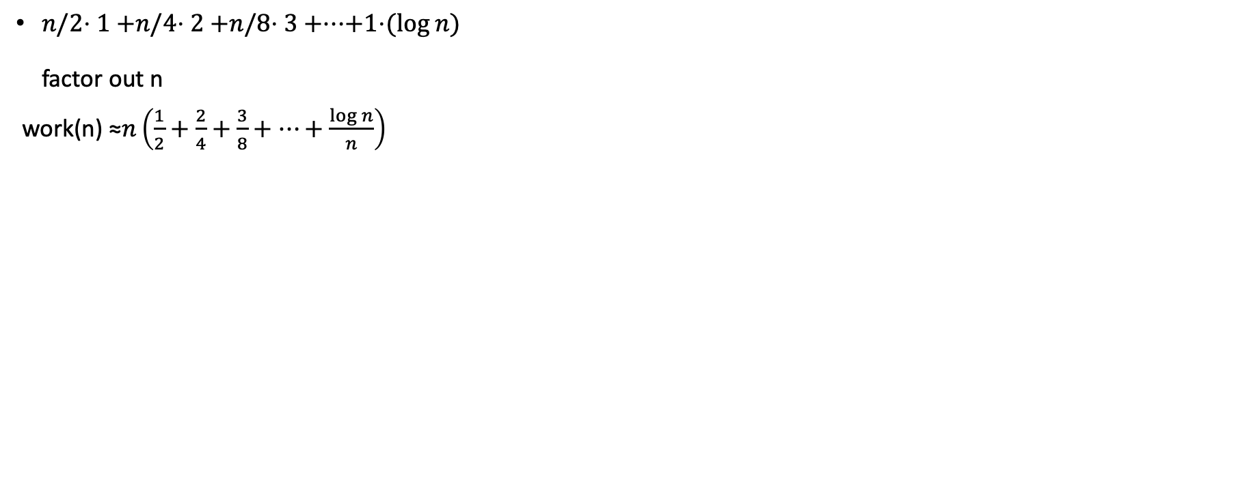

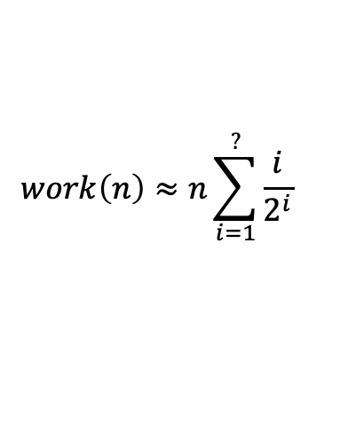
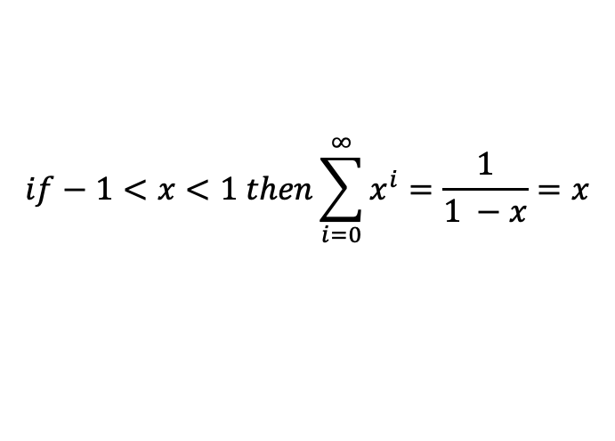
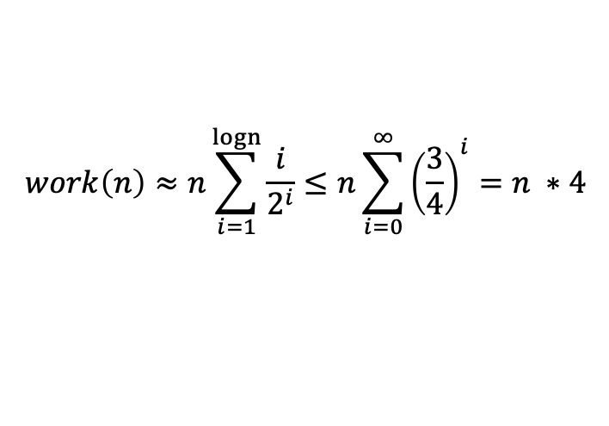
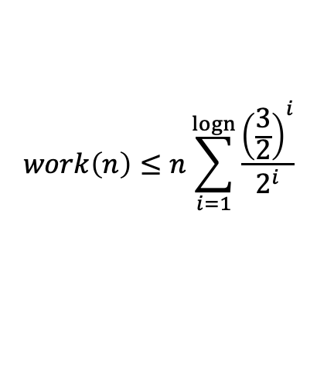
Optional Slide Floyd’s buildHeap Summation
find a pattern -> powers of 2
Summation!
? = upper limit should give last term
We don’t have a summation for this! Let’s make it look more like a summation we do know.
Infinite geometric series
Floyd’s buildHeap runs in O(n) time!

Slide 41
References
What Is a Binary Heap? By Spanning Tree
https://www.youtube.com/watch?v=AE5I0xACpZs
Can we represent a tree with an array? - Inside code
https://www.youtube.com/watch?v=EitnYxinKkw
Min Heap Animations | Data Structure | Visual How
https://www.youtube.com/watch?v=AFPzC2RJOMk
https://www.youtube.com/@visualhow/videos
Heaps // Michael Sambol
https://www.youtube.com/playlist?list=PL9xmBV_5YoZNsyqgPW-DNwUeT8F8uhWc6
Binary Min/Max Heap
https://www.youtube.com/playlist?list=PLvTjg4siRgU197GA1yFNRWUgsPZnvjuyL
HEAP SORT | Sorting Algorithms | DSA | GeeksforGeeks
https://www.youtube.com/watch?v=MtQL_ll5KhQ
2.6.3 Heap - Heap Sort - Heapify - Priority Queues (recommended)
https://www.youtube.com/watch?v=HqPJF2L5h9U&list=PLDN4rrl48XKpZkf03iYFl-O29szjTrs_O&index=32
Notes:
Visual How (min heap, max heap)

Slide 42
Full-Length Lectures
[CSE 373 WI24] Lecture 11: Intro to Heaps
https://www.youtube.com/watch?v=oRzWGbkKXFE&list=PLEcoVsAaONjd5n69K84sSmAuvTrTQT_Nl&index=10
[CSE 373 WI24] Lecture 12: Heap Implementation
https://www.youtube.com/watch?v=rYBFS2YpWNw&list=PLEcoVsAaONjd5n69K84sSmAuvTrTQT_Nl&index=11

